Slide 1
Towards an Efficient Face Searching Algorithm: Addressing Real-World Challenges
in Large-Scale Face Matching
(SegaFace)
Yuanbin Man (ybinman@bu.edu)
Pragya Sen (pragyas@bu.edu)
Rashanjot Kaur (rashan@bu.edu)
Dec. 2024

Slide 2
Outline
Face Matching Application
Face Matching Introduction
Methodology
Results and Evaluations
Conclusion

Slide 3
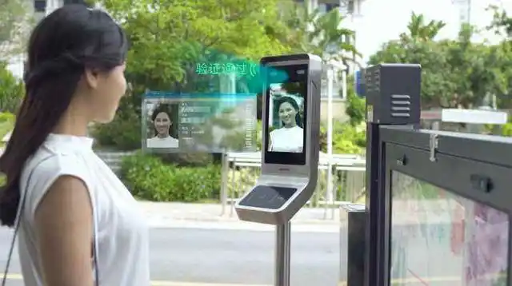
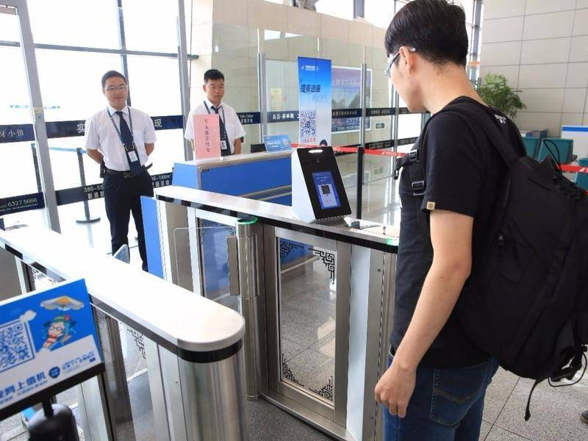
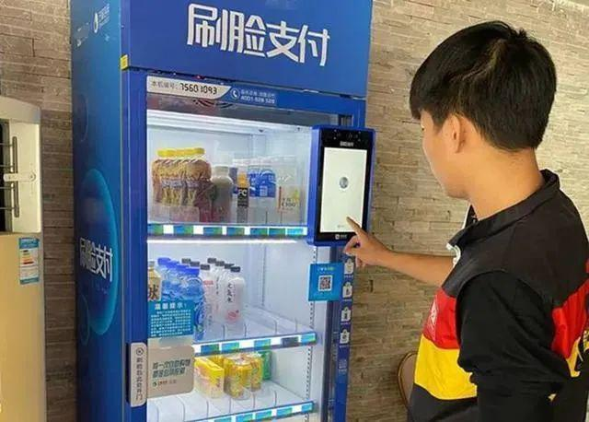
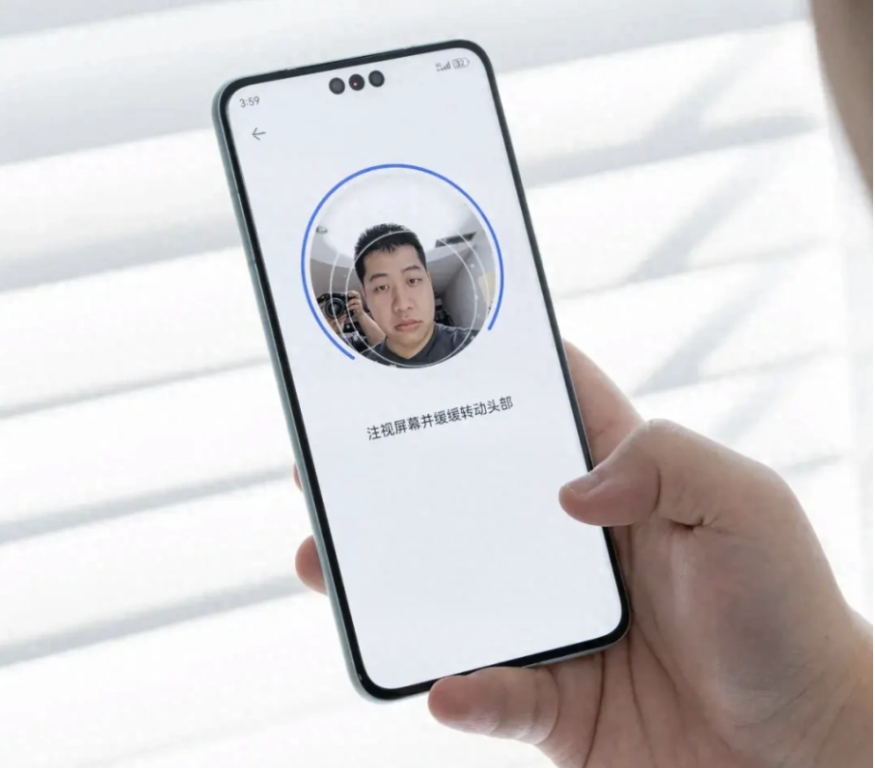
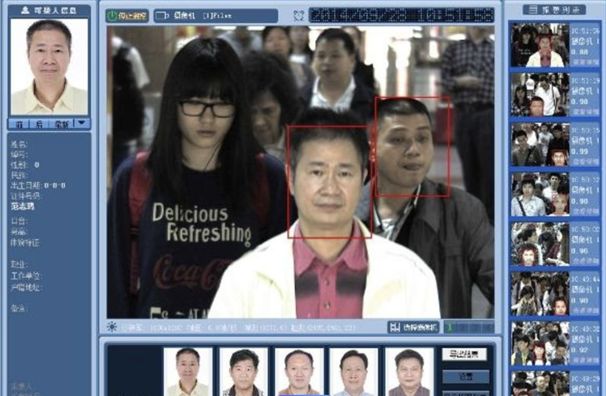
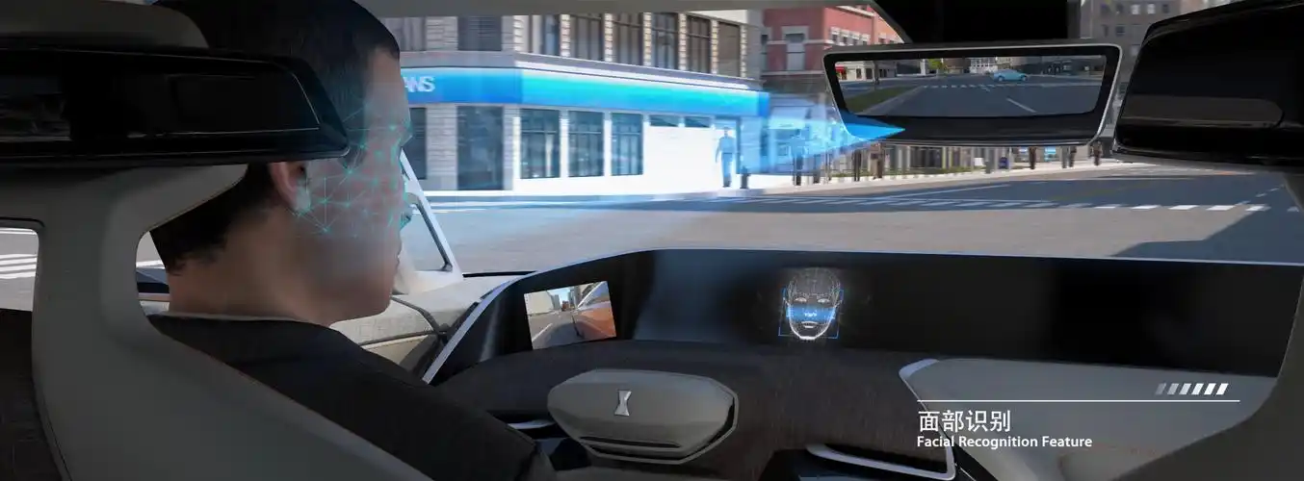
Face Matching Application
In China, your face serves as your ID.

Slide 4
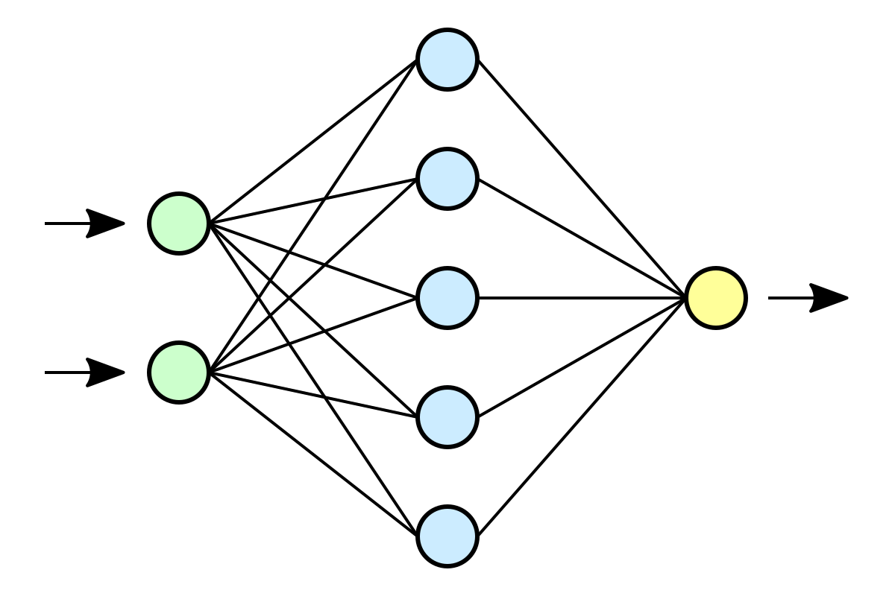
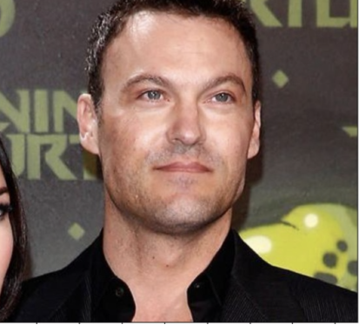








Face Matching Introduction (1)
Original
Detect Face
(MTCNN)
Face Encoding
(ResNet)
Facial Database
Face Embedding
Adam Smith
ID: xxxxxxx
Query
Response

Slide 5
Face Matching Introduction (2)
Approach:
Popular techniques, such as approximate nearest neighbor (ANN) searches and specialized vector databases, are often employed to handle the high-dimensional embeddings efficiently. However, balancing search speed and matching precision remains a fundamental challenge.
Our approach leverages advanced deep learning-based feature extraction, efficient vector indexing techniques, and adaptive similarity thresholds, optimizing the search process for both accuracy and speed.
Challenges:
Variations in lighting, pose, age progression, occlusions (e.g., glasses, masks), image quality
Additionally, with large-scale databases, real-time search performance becomes a critical issue, requiring efficient similarity search algorithms and data structures to handle millions of facial embeddings while maintaining accuracy.

Slide 6

Face Matching Methodology: Framework
The 3 main components involved are:
Face detection and Feature extraction: MTCNN (Multi-task Cascaded Convolutional Networks), InceptionResnetV1
Efficient indexing and Similarity search: Facebook Faiss Vector Database
Dynamic matching thresholds to enhance robustness and scalability

Slide 7
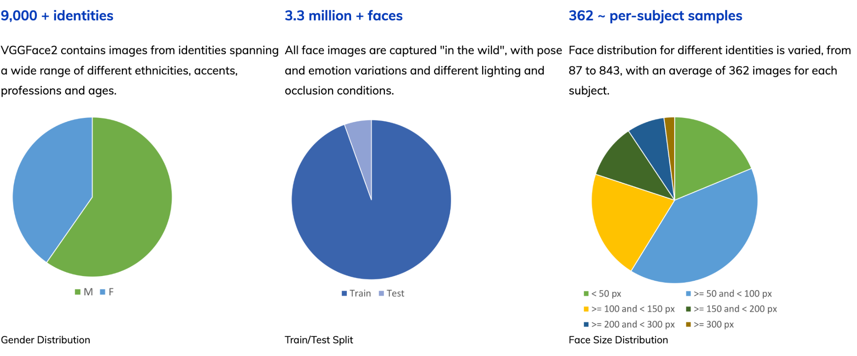
Face Matching Methodology: Dataset
VGGFace2 is a large-scale face recognition dataset. Images are downloaded from Google Image Search and have large variations in pose, age, illumination, ethnicity and profession.
Q. Cao, L. Shen, W. Xie, O. M. Parkhi and A. Zisserman, "VGGFace2: A Dataset for Recognising Faces across Pose and Age," 2018 13th IEEE International Conference on Automatic Face & Gesture Recognition (FG 2018),

Slide 8
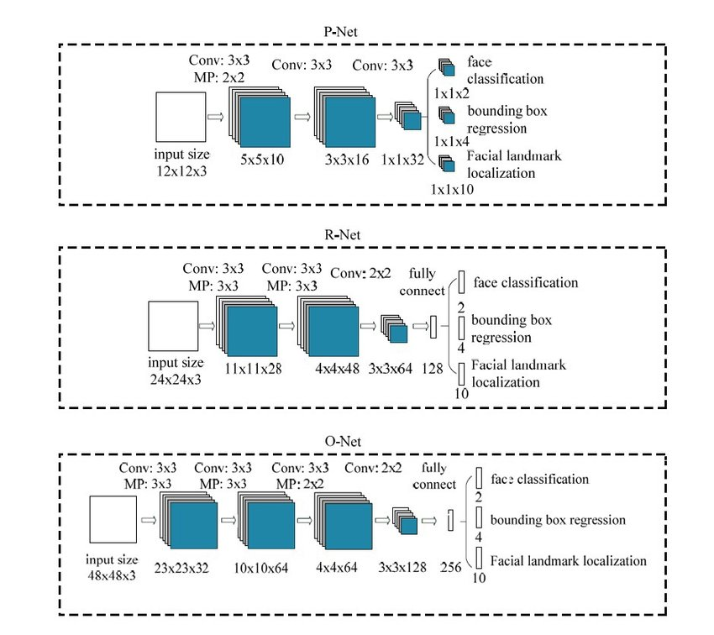
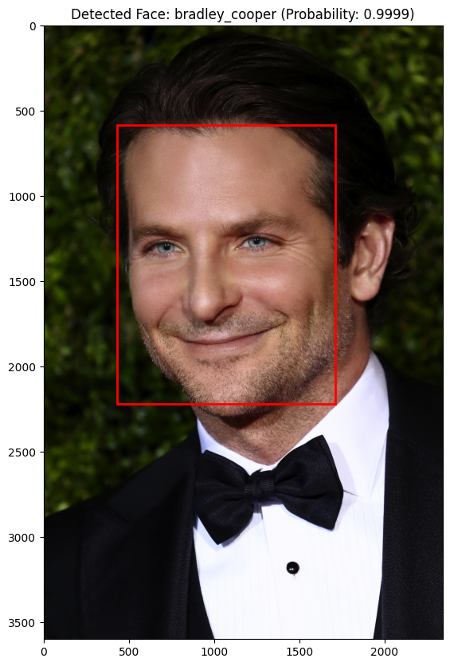
Face Matching Methodology: Face Detection & Feature Extraction
MTCNN Architecture
For initial face localization, we apply an object detection model (MTCNN) that can handle variations in in pose, lighting, and occlusions.
This step isolates faces from backgrounds, providing normalized images for consistent feature extraction.
Notes:
P-Net(Proposal Network): Produces multiple candidate windows
R-Net(Refine Network): Reduces the number of candidates
O-Net(Output Network): Provides the final output with key-points such as eyes, nose, etc.

Slide 9
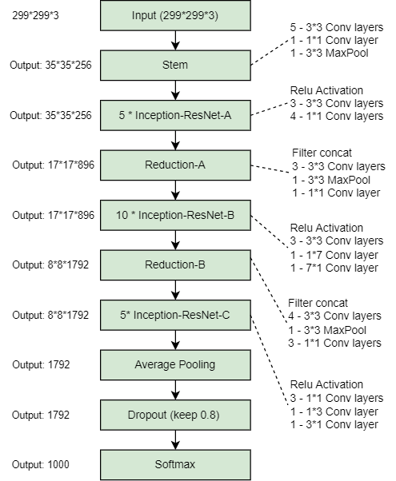
Face Matching Methodology: Face Embedding Database
Inception Resnet V1 Architecture
After detection, each face is converted into a feature embedding using a pre-trained model (Inception Resnet V1).
This embedding captures distinctive facial features in a high-dimensional space, allowing for accurate similarity comparisons with other embeddings in the database.
MTCNN will return images of faces all the same size, enabling easy batch processing with the Resnet recognition module.
Thus, a Facial Database is created for face searching.

Slide 10
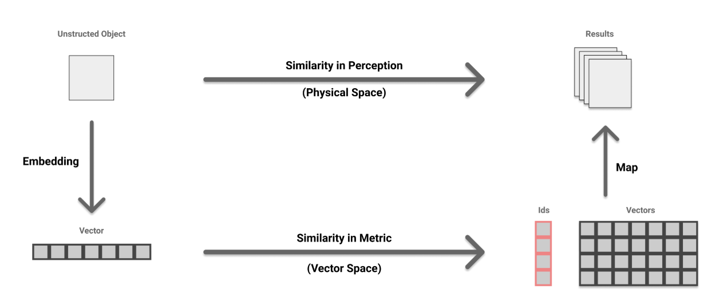
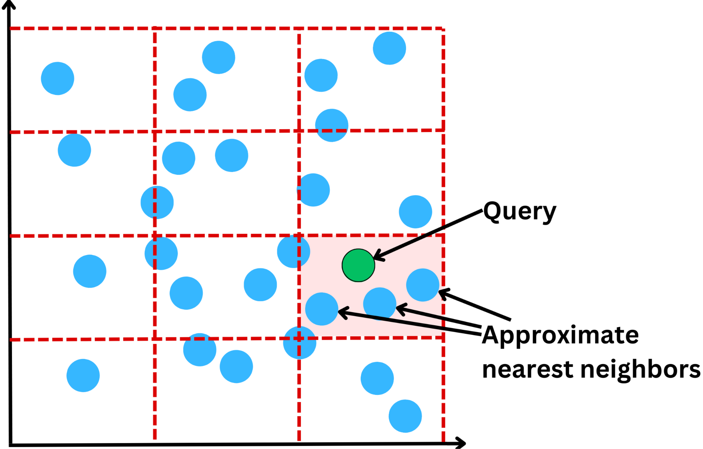
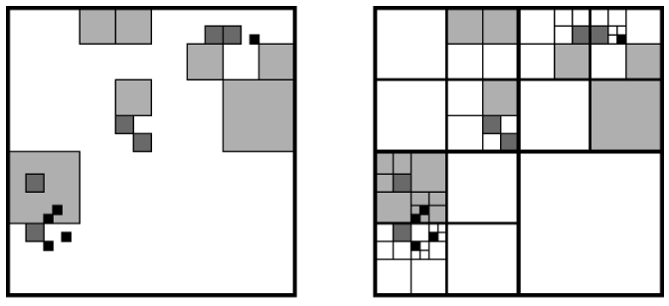
Face Matching Methodology: Indexing and Similarity Searching
FAISS (Facebook AI Similarity Search), an optimized library for similarity search that enables high-speed, large-scale embedding comparisons.
Indexing Technique: - Structure embeddings using a combination of IVF (Inverted File Index) and PQ (Product Quantization). - Multi-level index that partitions the embedding space, reducing the number of comparisons required by clustering similar embeddings together. - Product quantization further compresses each embedding to reduce storage requirements, making the system both memory and speed efficient.
Approximate Nearest Neighbor Search: - To quickly identify the most similar embeddings, we apply ANN search. - The IVF-PQ index enables efficient search by approximating the nearest neighbors, significantly reducing search time compared to brute-force methods. - For each query, only a subset of the dataset is compared, accelerating the retrieval process without sacrificing much accuracy.
conda install -c pytorch faiss-gpu
ANN

Slide 11
Face Matching Methodology: Dynamic Matching Thresholds
Threshold Calibration: - Using a validation dataset, we perform threshold calibration to determine optimal thresholds across various conditions. - For instance, lower thresholds are applied for images with significant variations (e.g., low light conditions or partial occlusions), while higher thresholds are used for clear, well-lit images.
Adaptive Matching: - During face matching, the system evaluates each query image’s characteristics (e.g., brightness, contrast) and dynamically adjusts the threshold accordingly. - This adaptive approach minimizes errors by allowing more lenient matching for challenging images while maintaining strict thresholds for clearer images, balancing precision and recall.

Slide 12
Face Matching Methodology: Scalability Enhancement
Batch Processing: - For batch face searches, such as real-time video analysis or large photo collections, we group queries and perform searches in parallel. - This improves throughput and reduces latency by maximizing resource utilization.
Caching and Embedding Update Strategies: - For frequently queried faces, we employ caching to store recent embeddings and results, reducing redundant calculations. - Embedding updates are scheduled periodically to ensure accuracy without overwhelming the system with continuous re-computation

Slide 13
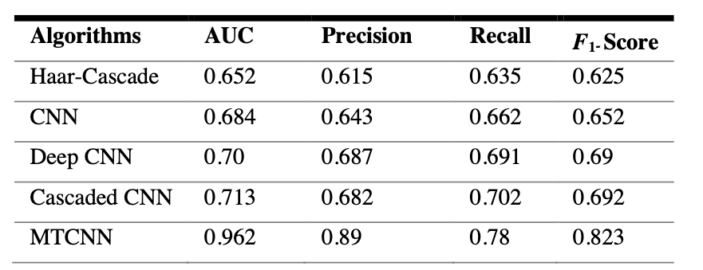
Face Matching Methodology: Evaluation and Results
Five machine learning algorithms have been applied to this fresh dataset.
MTCNN achieved the best accuracy, precision, recall, and F1-Score amongst the five algorithms.
Table: The result comparison between five machine learning algorithms.
MTCNN achieved 96.2% accuracy as compared to Cascaded CNN & Deep CNN with 71% and 70% accuracy respectively.
We found 68% accuracy in CNN and 65% accuracy on the Haar-Cascade classifier boosted with Gaussian Features.

Slide 14
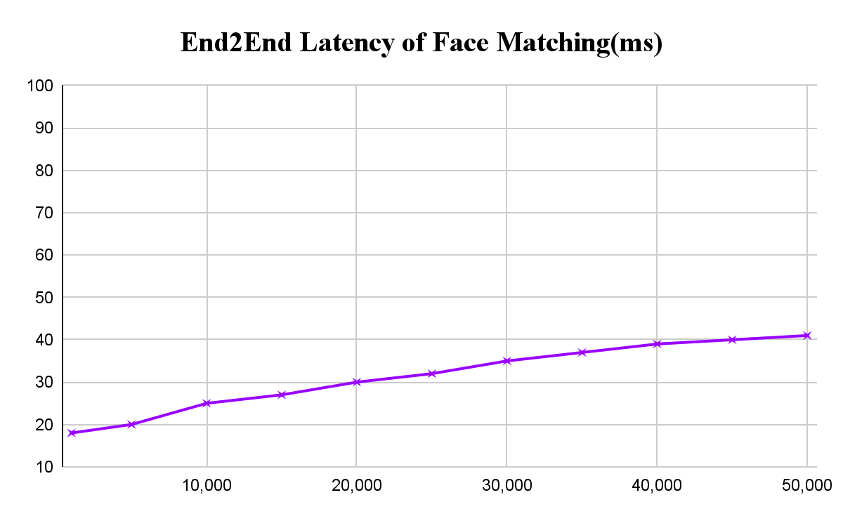
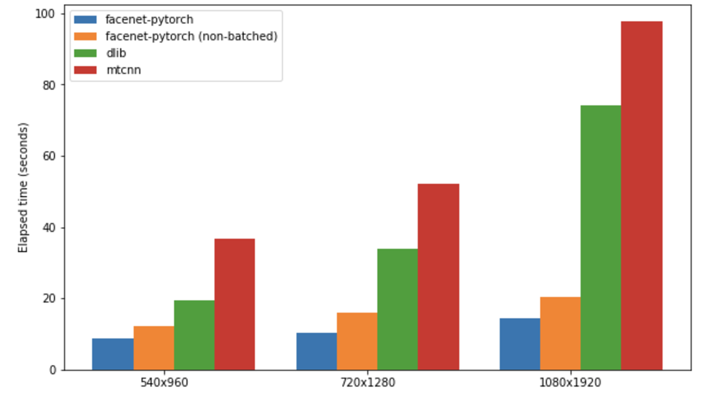
Face Matching Methodology: Evaluation and Results
Regarding the end-to-end latency (face detection, feature extraction, and searching via Faiss), it remains nearly constant, demonstrating the capability to handle large-scale face matching efficiently.
Due to its high efficiency, we also evaluated the face detection phase, achieving a detection time of 20ms. This enables real-time processing for video or online detection applications.

Slide 15
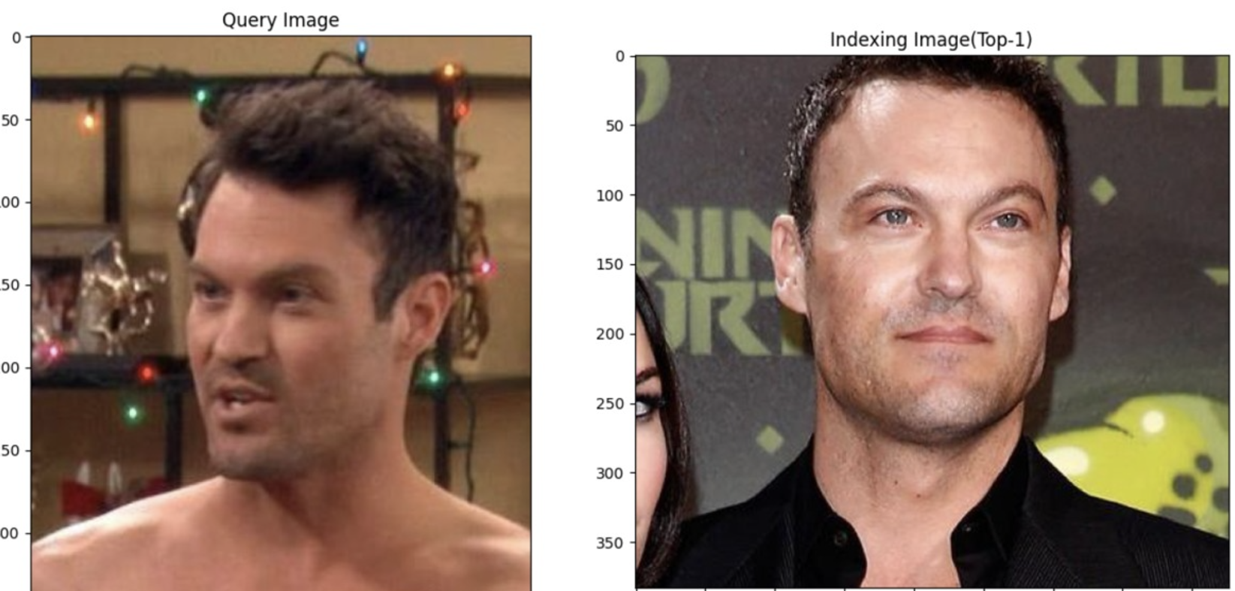
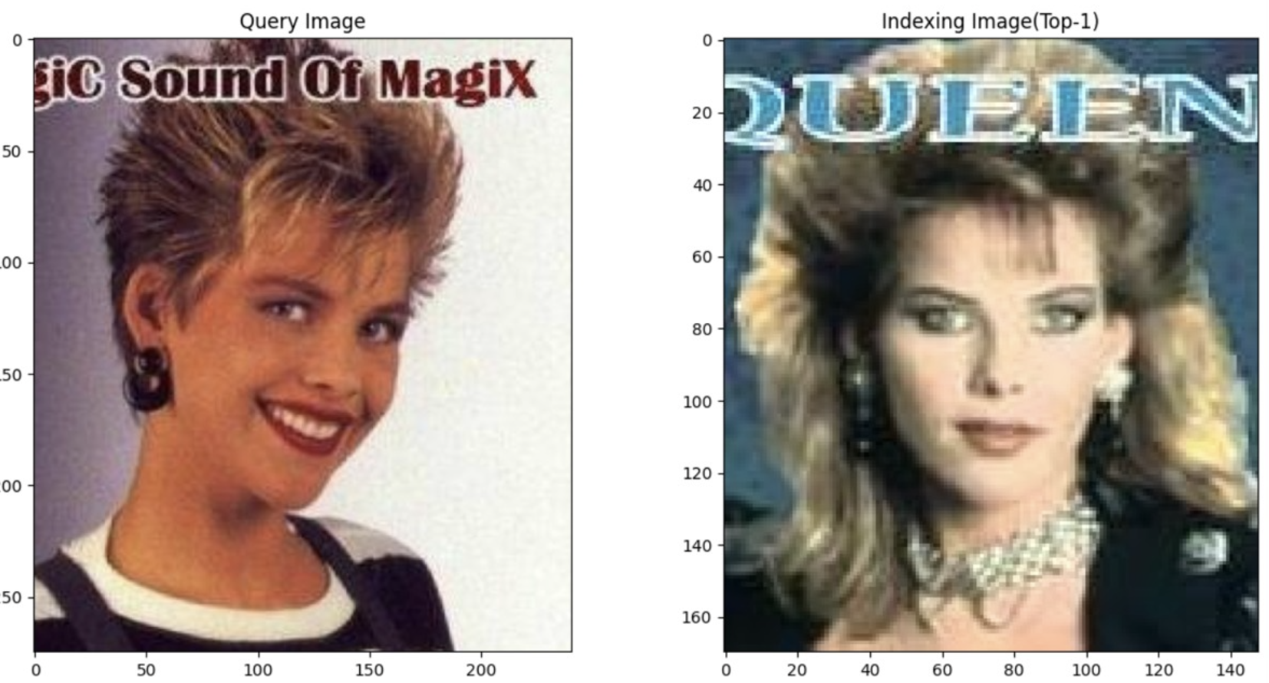
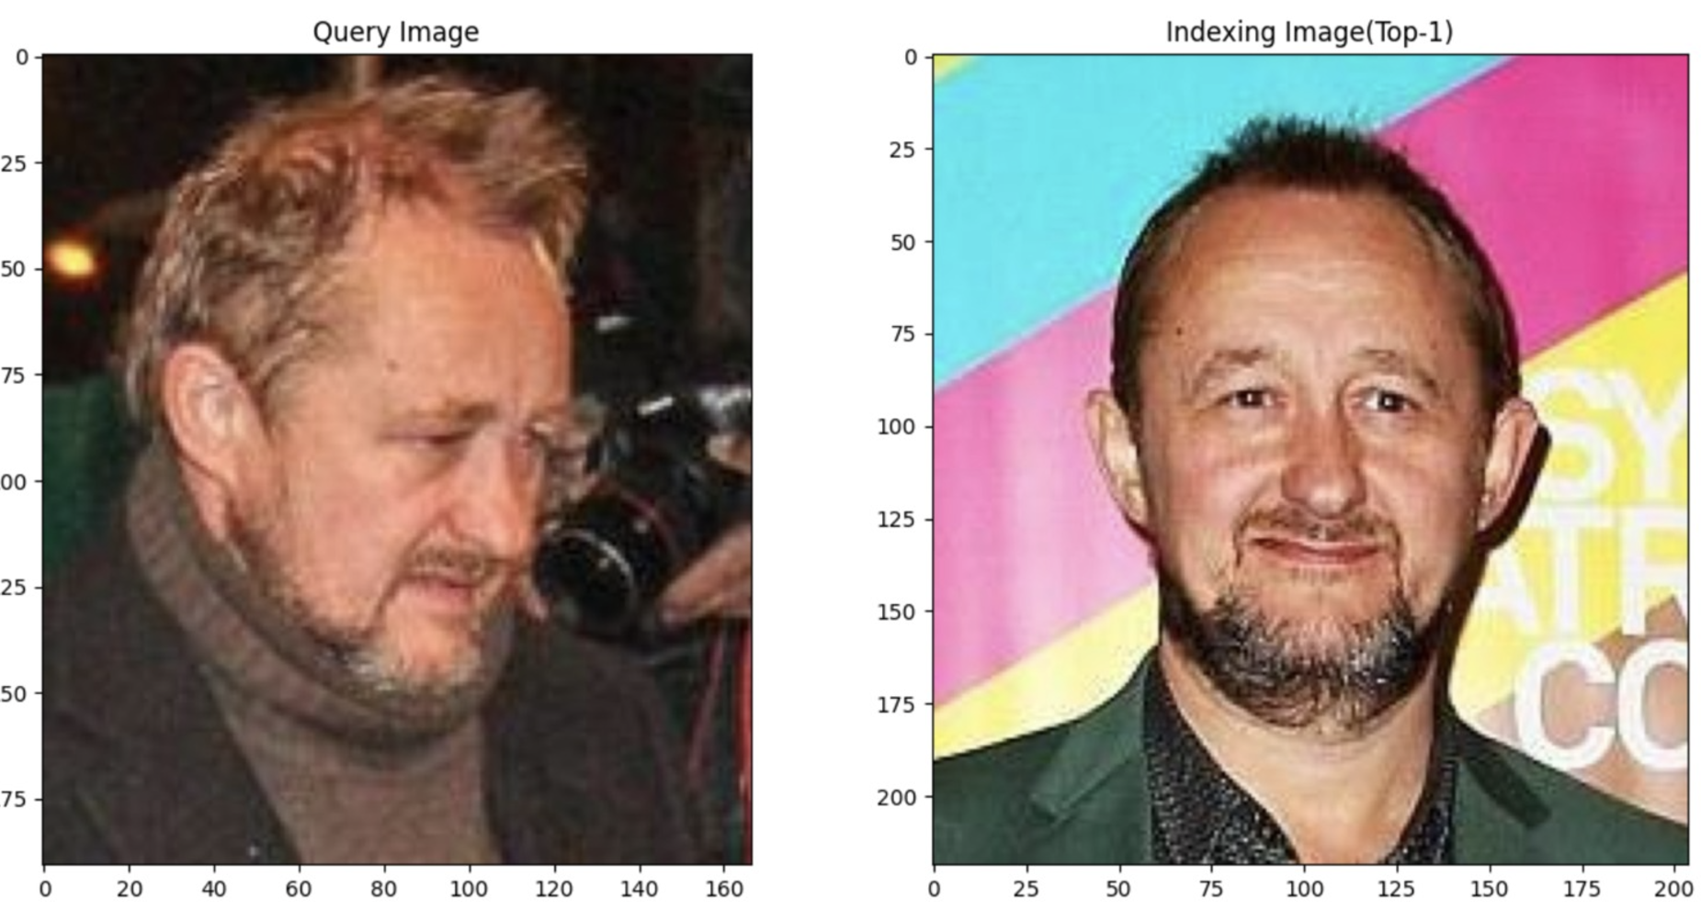
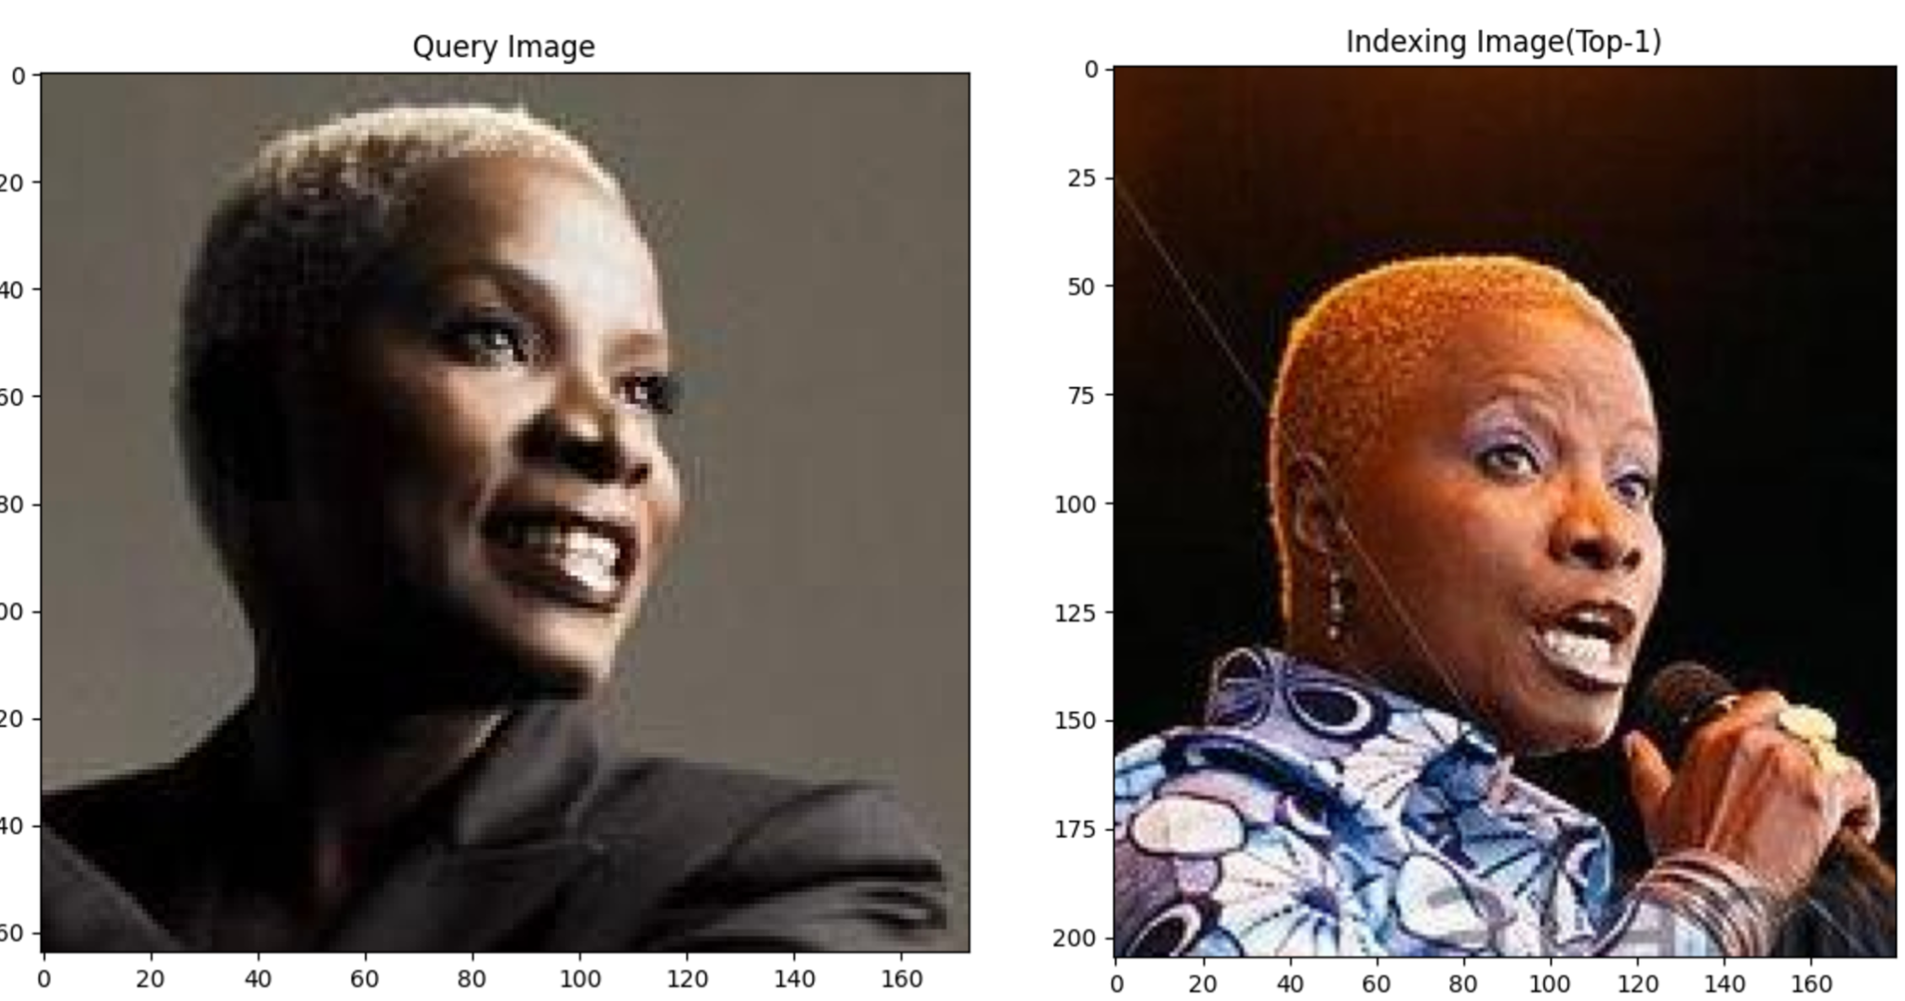
Face Matching Methodology: Demo
Query
Indexing
Query
Indexing
Query
Indexing
Query
Indexing

Slide 16
Face Matching Methodology: Conclusions
In our studies, we present an efficient face-searching algorithm tailored to address real-world challenges in large-scale face matching. By leveraging MTCNN for accurate face detection, achieving an impressive 96.2% accuracy, and employing ResNet to extract robust 512-dimensional face features, we ensure high reliability in feature representation. For efficient similarity searches, we integrate over 3 million face embeddings into a Meta-FAISS vector dataset using a combination of IVF (Inverted File Index) and PQ (Product Quantization), achieving an average latency of 50ms. Our approach demonstrates the effectiveness of combining state-of-the-art detection, feature extraction, and indexing techniques for scalable and rapid face matching, offering practical solutions for real-world applications.

Slide 17
Thanks for your attention.

